Slide 1

Assignment
Course Code : CSE 417
Course Title : Web Engineering
Submitted To :
Mushfiqur Rahman
Lecturer
Department Of CSE
Daffodil International University
Submitted By :
Ismail Hasan Sarker
ID : 181-15-1815
Sec: PC-C
Department Of CSE
Daffodil International University

Slide 2
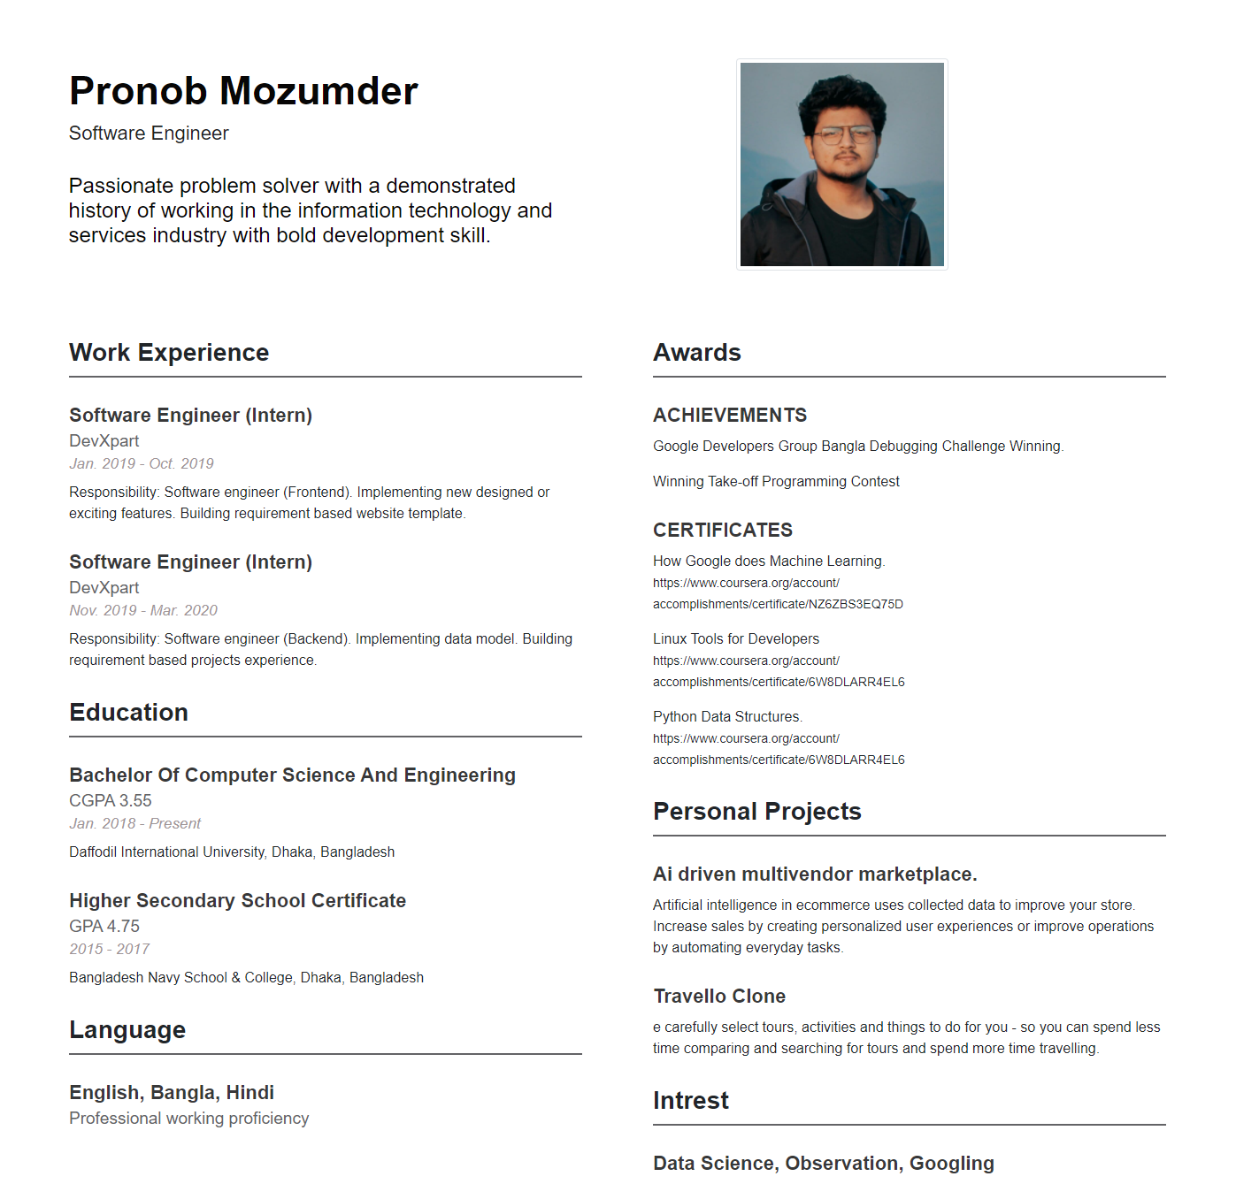
Question 1: Make a CV in HTML format.
Output :

Slide 3
Code : html
<!DOCTYPE html>
<html lang="en">
<head>
<meta charset="UTF-8">
<meta name="viewport" content="width=device-width, initial-scale=1.0">
<title>Document</title>
<link href="https://cdn.jsdelivr.net/npm/bootstrap@5.0.0-beta1/dist/css/bootstrap.min.css" rel="stylesheet"
integrity="sha384-giJF6kkoqNQ00vy+HMDP7azOuL0xtbfIcaT9wjKHr8RbDVddVHyTfAAsrekwKmP1" crossorigin="anonymous">
<link rel="stylesheet" href="style.css">
</head>
<body>
<div class="container">
<div class="row">
<div class="col-xs-12 col-md-6" id="resHead">
<h1>Pronob Mozumder</h1>
<h3>Software Engineer</h3>
<br>
<h4>Passionate problem solver with a demonstrated history of working in the information technology and services industry with bold development skill.</h4>
</a>
</div>

Slide 4
<div class="col-xs-12 col-md-4" id="resHead2">
<img src="photo.jpg" class="img-thumbnail rounded float-left">
</div>
</div>
<div class="row">
<div class=" col-md-6" id="workExp">
<h1 class="heading">Work Experience</h1>
<h2 class="title">Software Engineer (Intern)</h2>
<h3 class="subtitle">DevXpart</h3>
<h4 class="date">Jan. 2019 - Oct. 2019</h4>
<p>
Responsibility: Software engineer (Frontend). Implementing new designed or exciting features. Building requirement based website template.
</p>
<h2 class="title">Software Engineer (Intern)</h2>
<h3 class="subtitle">DevXpart</h3>
<h4 class="date">Nov. 2019 - Mar. 2020</h4>
<p>
Responsibility: Software engineer (Backend). Implementing data model. Building requirement based projects experience.
</p>
<h1 class="heading">Education</h1>
<h2 class="title">Bachelor Of Computer Science And Engineering</h2>
<h3 class="subtitle">CGPA 3.55 </h3>
<h4 class="date">Jan. 2018 - Present</h4>
<p>Daffodil International University, Dhaka, Bangladesh</p>
<h2 class="title">Higher Secondary School Certificate</h2>
<h3 class="subtitle">GPA 4.75 </h3>
<h4 class="date">2015 - 2017</h4>
<p>Bangladesh Navy School & College, Dhaka, Bangladesh</p>

Slide 5
<h1 class="heading">Language</h1>
<h2 class="title">English, Bangla, Hindi</h2>
<h3 class="subtitle">Professional working proficiency </h3>
</div> <div class="col-md-6" id="skillEdu">
<h1 class="heading">Awards</h1>
<h2 class="title">ACHIEVEMENTS</h2>
<p>Google Developers Group Bangla Debugging Challenge Winning.</p>
<p>Winning Take-off Programming Contest</p> <h2 class="title">CERTIFICATES</h2>
<p>How Google does Machine Learning. <br> <small>https://www.coursera.org/account/<br>accomplishments/certificate/NZ6ZBS3EQ75D</small></p>
<p>Linux Tools for Developers <br> <small>https://www.coursera.org/account/<br>accomplishments/certificate/6W8DLARR4EL6</small></p>
<p>Python Data Structures. <br> <small>https://www.coursera.org/account/<br>accomplishments/certificate/6W8DLARR4EL6</small></p>
<h1 class="heading">Personal Projects</h1>
<h2 class="title">Ai driven multivendor marketplace.</h2>
<p>
Artificial intelligence in ecommerce uses collected data to improve your store. Increase sales by creating personalized user experiences or improve operations by automating everyday tasks. </p>
<h2 class="title">Travello Clone</h2>
<p>
e carefully select tours, activities and things to do for you - so you can spend less time comparing and searching for tours and spend more time travelling.
</p> <h1 class="heading">Intrest</h1>
<h2 class="title">Data Science, Observation, Googling</h2>
</div>
</div>
</div>
</body> </html>

Slide 6
Code: css
* {
font-family: 'Roboto', sans-serif;
-webkit-font-smoothing: antialiased;
-moz-osx-font-smoothing: grayscale;
} #resHead {
text-align: left;
color: rgb(7, 6, 6);
padding-top: 5%;
padding-right: 5%;
padding-bottom: 2%;
padding-left: 3%;
} #resHead2 {
text-align: right;
padding-top: 5%;
padding-right: 5%;
padding-bottom: 2%;
padding-left: 3%;
} #resHead h3 {
color: #212224;
font-size: 22px;
} .img-thumbnail {
padding: .25rem;
background-color: #fff;
border: 1px solid #dee2e6;
border-radius: .25rem;
max-width: 100%;
height: 15rem;
}

Slide 7
#resHead h1 {
font-weight: bold;
font-size: 45px;
} h1 {
margin-top: 10px;
font-weight: bold;
} #workExp,
#skillEdu {
margin: 20px 0px 5px 0px;
padding-left: 40px;
padding-right: 40px;
} .contact {
background-color: #383839;
color: #fff;
margin-top: 30px;
} .contact .title,
.contact .subtitle {
color: #fff;
text-align: center;
} .contact .title {
margin-top: 15px;
margin-bottom: 15px;
} .contact img {
margin: 0 auto;
padding: 15px 15px 0px 15px; }

Slide 8
.contact p {
margin-bottom: 15px;
line-height: 30px;
} .heading {
font-size: 28px;
padding-bottom: 10px;
border-bottom: 2px solid #636366;
margin-top: 30px;
} .title {
color: #383839;
margin: 0px;
margin-top: 30px;
font-size: 22px;
padding-bottom: 5px;
font-weight: bold;
} .subtitle {
padding-bottom: 5px;
margin: 0px;
color: #636366;
font-size: 19px;
} .date {
padding-bottom: 5px;
margin: 0px;
color: #9E9598;
font-style: italic;
font-size: 17px;
} p {
font-size: 16px;
margin-top: 5px;
}

Slide 9
a:link {
color: #fff;
}
a:visited {
color: #fff;
}
a:hover {
color: #636366;
text-decoration: underline;
}
a:active {
color: #fff;
}
@media (max-width: 992px; ) {
.heading,
.title,
.date,
.subtitle {
text-align: center;
}
}

Slide 10
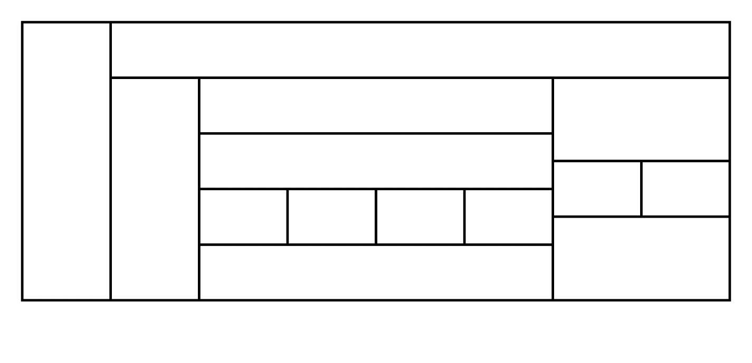
Question 2: Construct the following table.
Output : HTML Table
Code :
<html>
<style>
table, th, td {
border: 1px solid black;
border-collapse: collapse;}
</style>
<body>
<table width='100%'>
<tr>
<td rowspan="7">&nbsp;</td>
<td colspan="7">&nbsp;</td>
</tr>
<tr>
<td rowspan="6">&nbsp;</td>
<td colspan="4">&nbsp;</td>

Slide 11
<td colspan="2" rowspan="2">&nbsp;</td>
</tr>
<tr>
<td colspan="4" rowspan="2">&nbsp;</td>
</tr>
<tr>
<td rowspan="2">&nbsp;</td>
<td rowspan="2">&nbsp;</td>
</tr>
<tr>
<td rowspan="2">&nbsp;</td>
<td rowspan="2">&nbsp;</td>
<td rowspan="2">&nbsp;</td>
<td rowspan="2">&nbsp;</td>
</tr>
<tr>
<td colspan="2" rowspan="2">&nbsp;</td>
</tr>
<tr>
<td colspan="4">&nbsp;</td>
</tr>
</table>
</body>
</html>

